Slide 1
Granger Causality
Bence Pal, Rita Naumenko

Slide 2
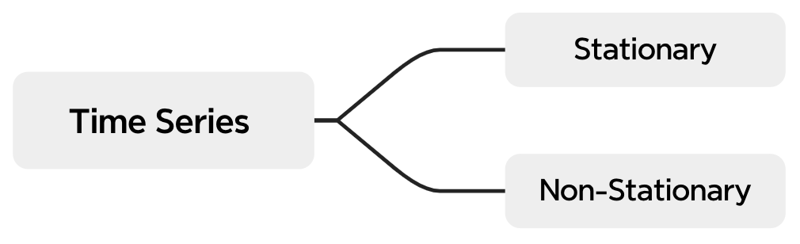
What is Time Series?
Time Series is a series of data points indexed in time order.
Most commonly, taken at successive equally spaced points in time
Plotted on a run chart (= temporal line chart)
Components: Trend, Seasonality, Cyclicity, Irregularity
Examples of Time Series
Stock prices
Weather data
Heart rate monitor data
Interest rates

Slide 3
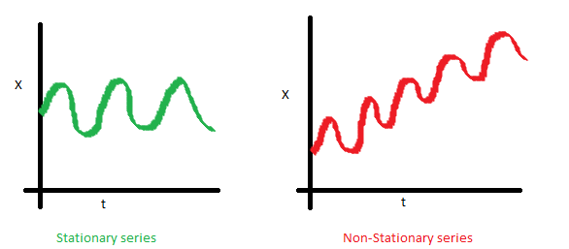
Stationary vs. Non-Stationary Time Series
What does it mean for data to be stationary?
1) The mean of the series should not be a function of time. The data on the red graph below is not stationary because the mean increases over time.

Slide 4
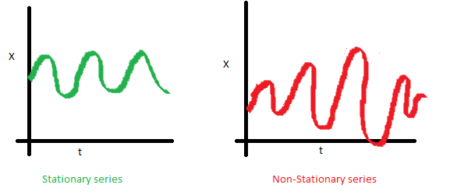
2) The variance of the series should not be a function of time (homoscedasticity). The data on the red graph below is not stationary because there is a varying spread of data over time.

Slide 5
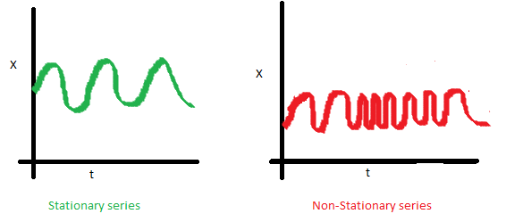
3) The covariance of the i-th term and the (i + m)-th term should not be a function of time. In the red graph, you can notice the spread becomes closer as the time increases. Hence, the covariance is not constant with time.

Slide 6
Our Data
Dataset
Yahoo Finance daily closing stock price data for 3 leading U.S. companies:
Apple (AAPL)
Walmart (WMT)
Tesla (TSLA)
Time Frame
Nov 1, 2014 - Nov 1, 2024

Slide 7
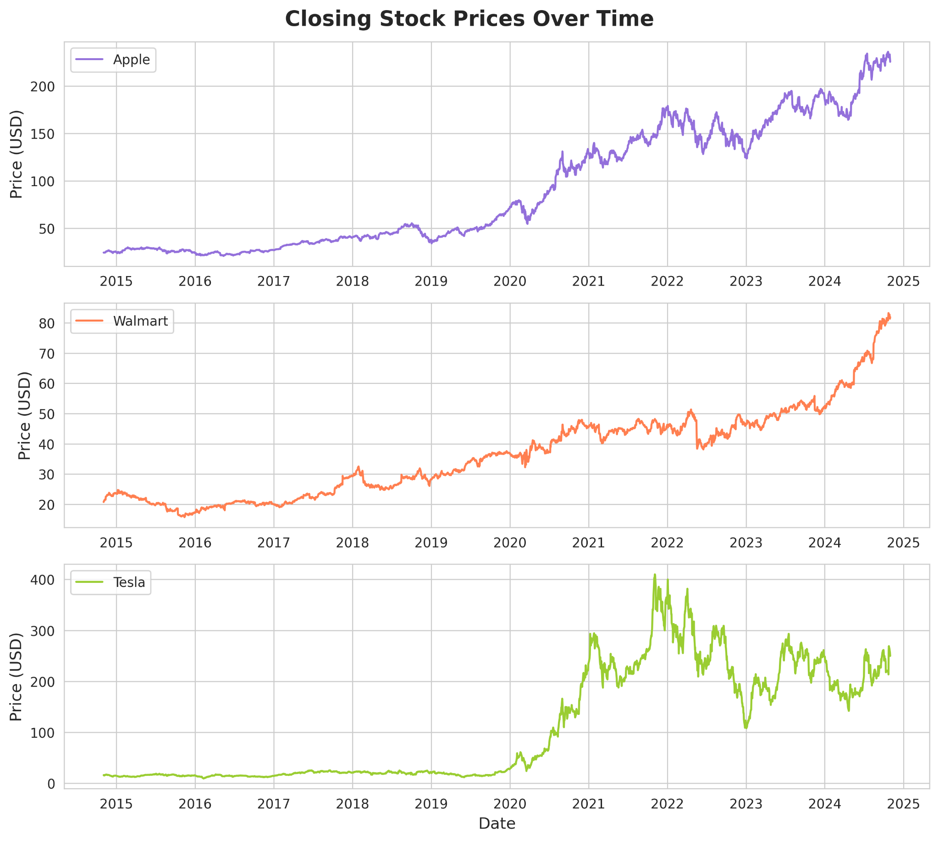




Slide 8
What is Granger Causality?
Granger Causality – a statistical hypothesis test for determining whether one time-series is useful in forecasting another.
A time series X is said to:
Granger-cause Y if it is helpful for forecasting the other variable
Fail to Granger-cause Y if it is not helpful for forecasting the other variable
Underlying principles of the causality relationship (according to Granger):
The cause happens prior to its effect
The cause has unique information about the future values of its effect

Slide 9
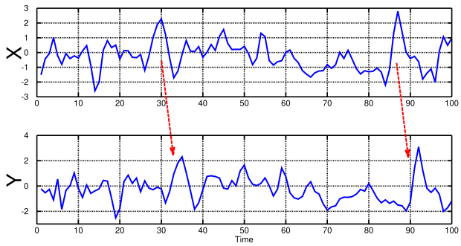
Intuition Behind
Interested in forecasting performance, not the theoretical model behind the forecast
No “real causation”, rather “predictive causation”
If lagged values of X and Y are better at predicting Y than lags of Y on its own then X Granger-causes Y

Slide 10
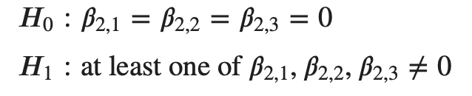
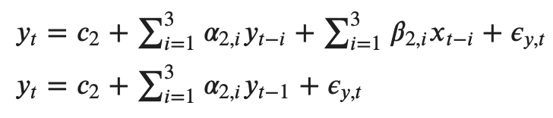
Method
Choose the number of lags to include (here 3)
Regress lagged values of Y on Y, then regress lagged values of X and Y on Y to capture the forecasting effect of X on Y
Test the significance of the lagged values of X (here ꞵ)
Note: The test can be expanded to the multivariate case
hypothesis formulation
system
modeling

Slide 11
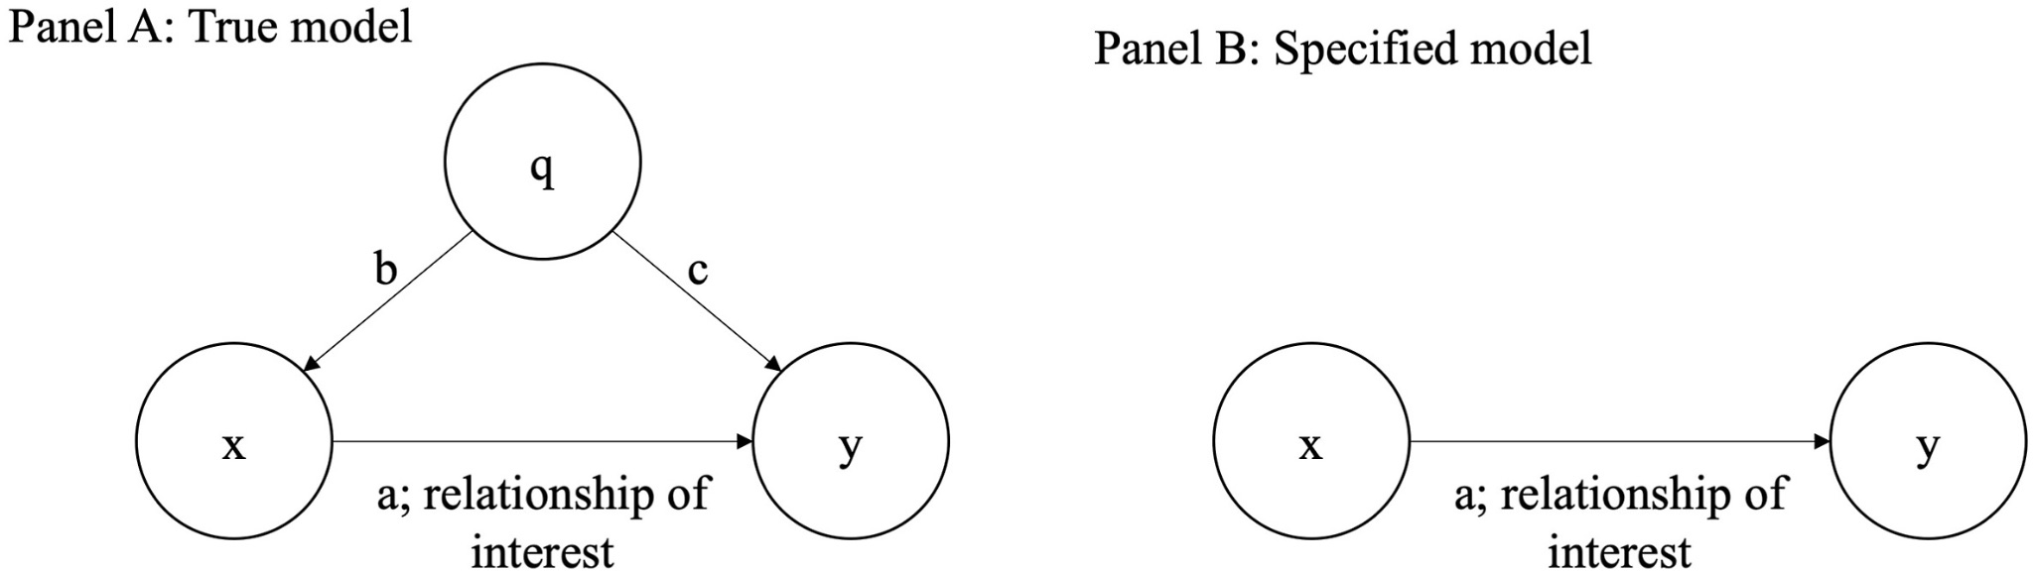
Limitations
Little insight into the theoretical model behind the relationship
Requires stationary data
Captures only linear “causal” relationships
In the multivariate case it is hard to isolate the true effect of X
Ambiguity in the case of bidirectional causality
Omitted variable bias

Slide 12
Bibliography
https://www.aptech.com/blog/introduction-to-granger-causality/
https://towardsdatascience.com/a-quick-introduction-on-granger-causality-testing-for-time-series-analysis-7113dc9420d2
https://otexts.com/fpp2/stationarity.html
https://en.wikipedia.org/wiki/Granger_causality
https://www.seanabu.com/2016/03/22/time-series-seasonal-ARIMA-model-in-python/
https://mlpills.dev/time-series/stationarity-in-time-series-and-how-to-check-it/

Slide 13
Thank You!
Do you have any questions?

